Slide 1
Activity 6: MORPHOLOGICAL OPERATIONS
Genesis Vertudez – 202003099
App Physics 157 - Computational Analysis and Modeling in Physics
Submitted to Dr. Maricor Soriano; Mx. Rene Principe Jr.

Slide 2
OBJECTIVES
Perform morphological operations manually on images given a structuring element
Verify the results numerically
Improve segmented images using morphological operations

Slide 3
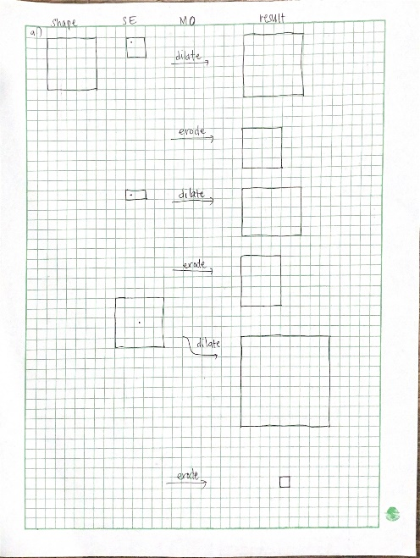
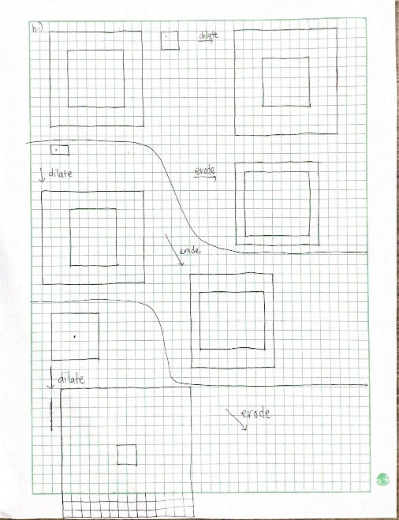
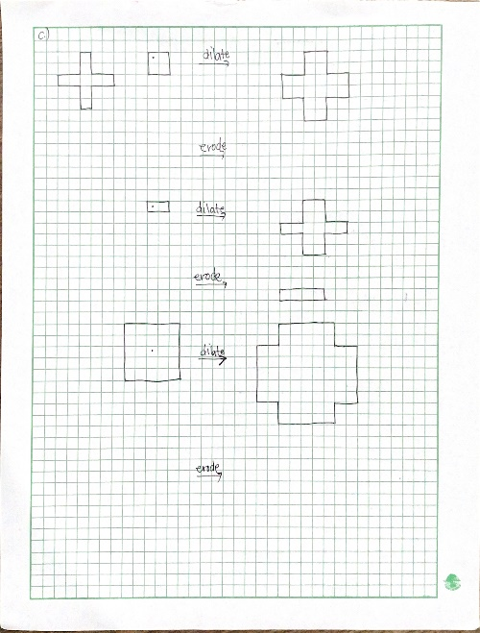
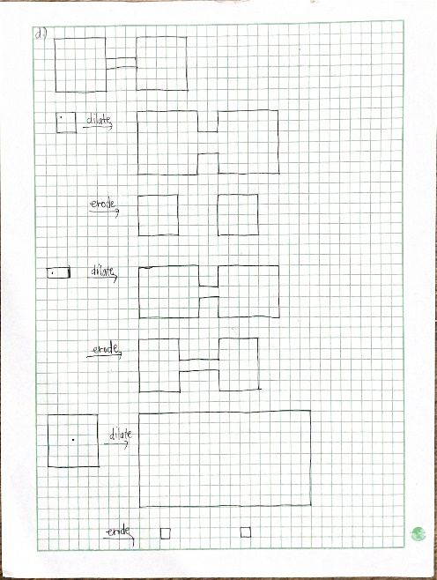
MORPHOLOGICAL OPERATIONS - MANUAL
Morphological operations are usually used on binary images of 0’s and 1’s where the 1’s constitute the image. As the name suggests, they are operations used to manipulate the morphology, or shape, of an image based on a given structuring element (SE). The common morphological operations include the dilation, erosion, opening (erode then dilate), and closing (dilate then erode) operation.
Before trying out the morphological operations available in Python, I tried mapping the results in a graphing paper. Dilation “extends” an image, while erosion “contracts” it. Dilation works by overlapping the origin of the SE over different pixels, and “turning on”, or switching that pixel to a 1 IF the image and the structuring element overlap even by one pixel. On the other hand, erosion works by again overlapping the origin of the SE over different pixels, and turning it on only when the SE is fully inside the image.
Solid square
Hollow square
Plus symbol
Dumbell
Codes and files: https://github.com/genvert/AP_157_FX-2_Vertudez/tree/main/Activity%206

Slide 4
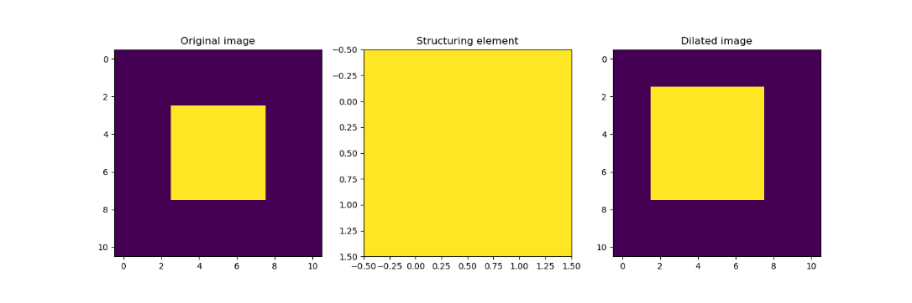
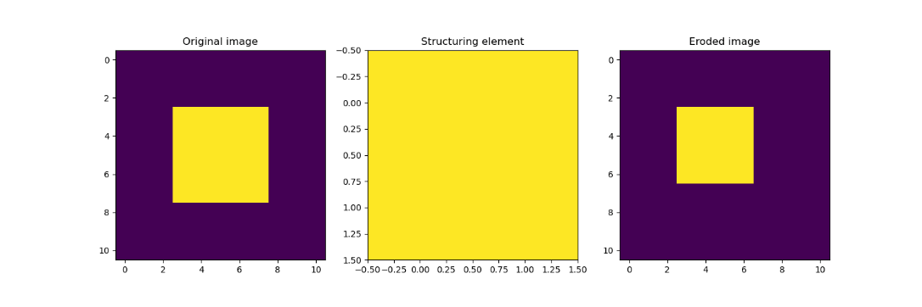
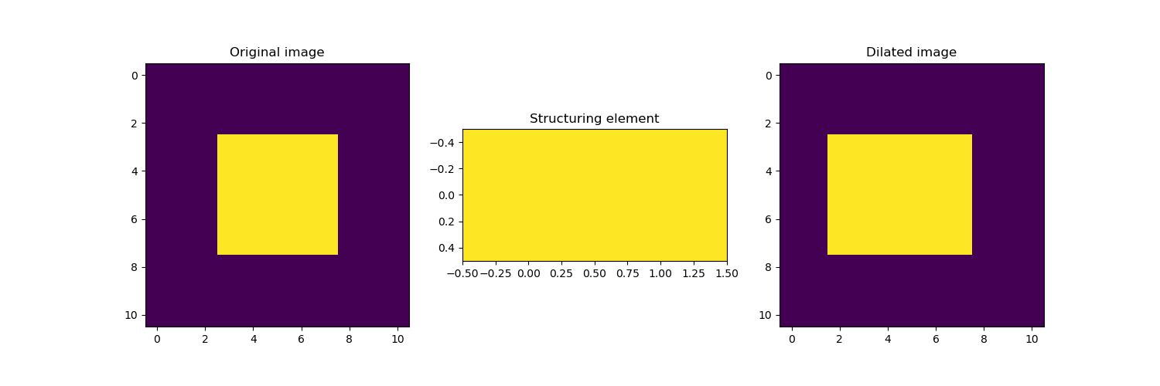
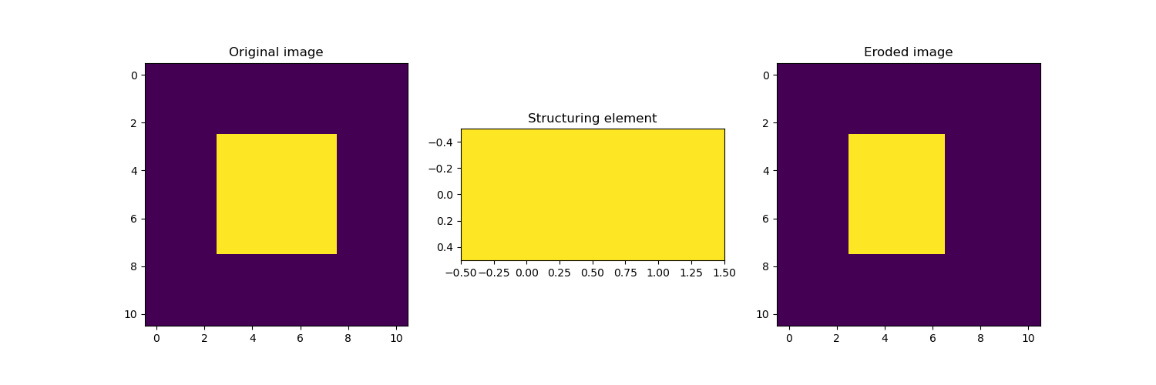
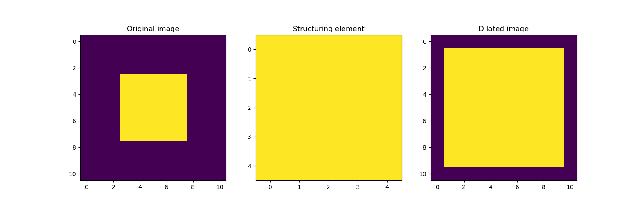
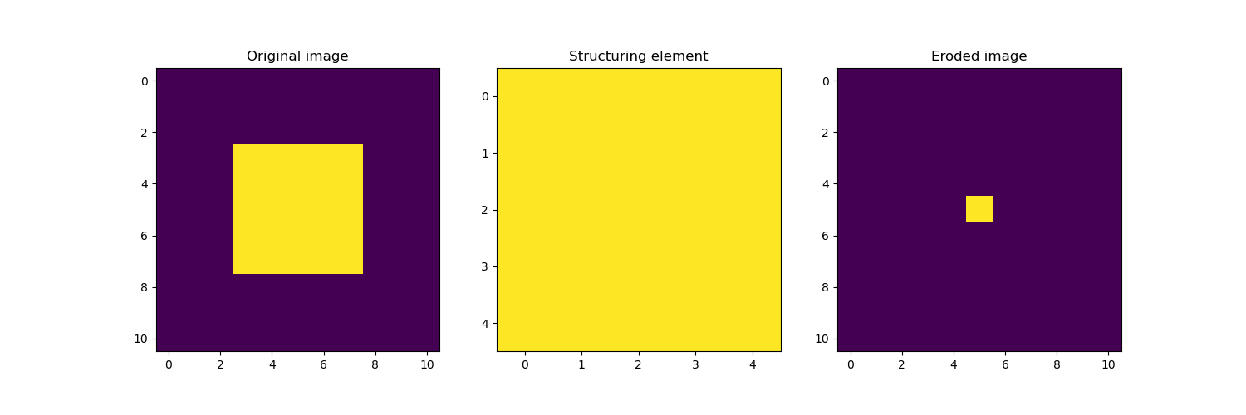
MORPHOLOGICAL OPERATIONS - NUMERICAL
Now, it’s time to try them numerically with Python. The images, as before, are a 5x5 solid square, 10x10 hollow square that is 2 units thick, a plus symbol, and a dumbbell. The structuring elements are still a 2x2 solid square, a 2x1 solid rectangle, and a 5x5 solid square.
Image: Solid square
Dilation
Erosion
As we can see, the dilated square becomes larger, while the eroded one gets smaller, as expected. The structuring element determines the final shape of the object.
The anchor point for the first two SEs is the (0,0) pixel, while the third one is the center, that is why the result is not centered on the first two.
Still, note that if the structuring element is symmetrical, then the final image just gets translated if you change anchor point.
Codes and files: https://github.com/genvert/AP_157_FX-2_Vertudez/tree/main/Activity%206

Slide 5
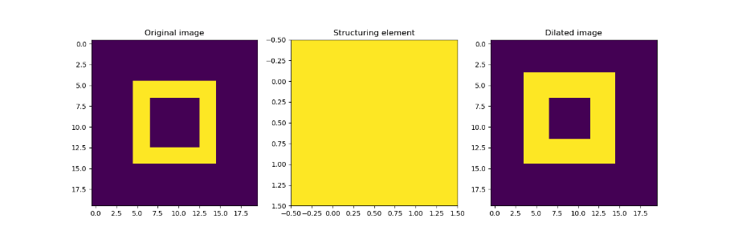
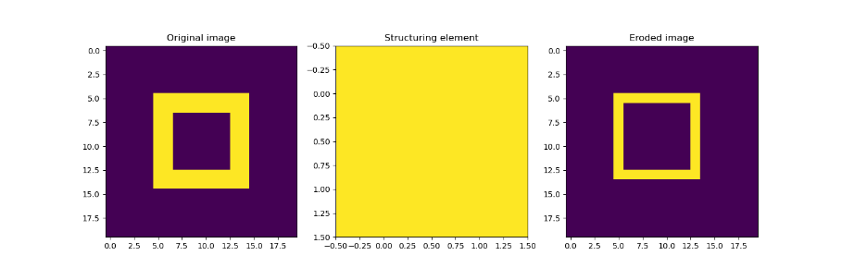
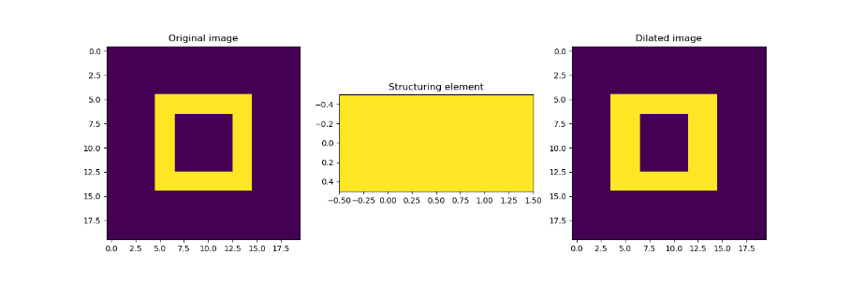
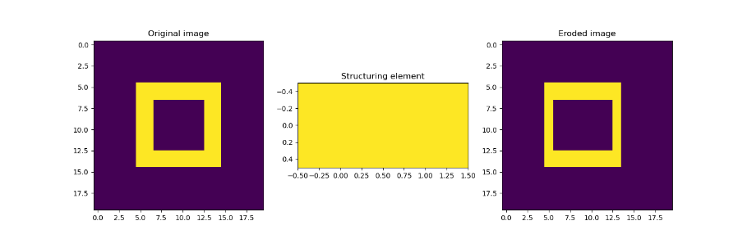
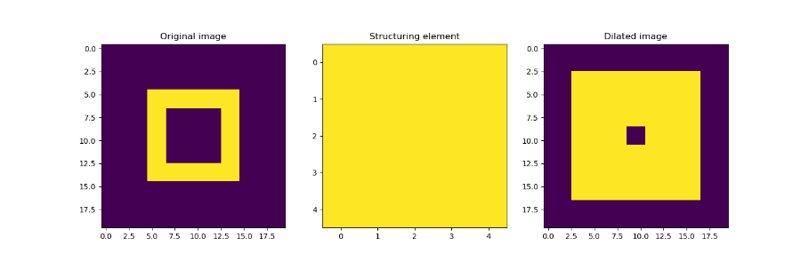
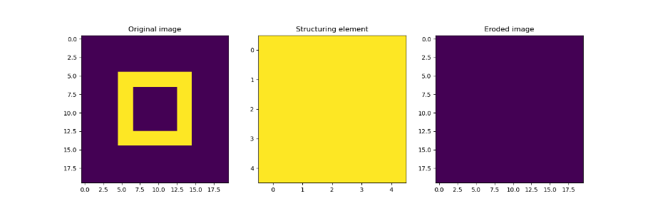
MORPHOLOGICAL OPERATIONS - NUMERICAL
Image: Hollow square
Dilation
Erosion
Again, the dilated square becomes larger, while the eroded one gets smaller, as expected.
Since the hollow square is 2 pixel thick, eroding it with a 5x5 square deletes the whole image since the 5x5 square does not fit anywhere in the image, as seen in the last image on the right.
Codes and files: https://github.com/genvert/AP_157_FX-2_Vertudez/tree/main/Activity%206

Slide 6
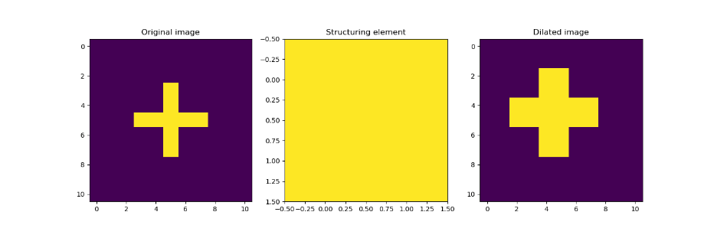
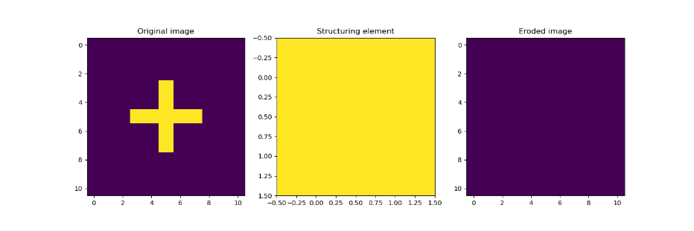
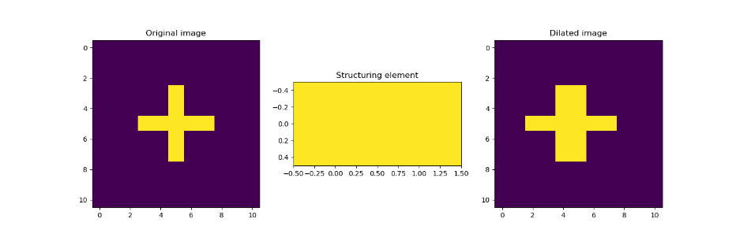
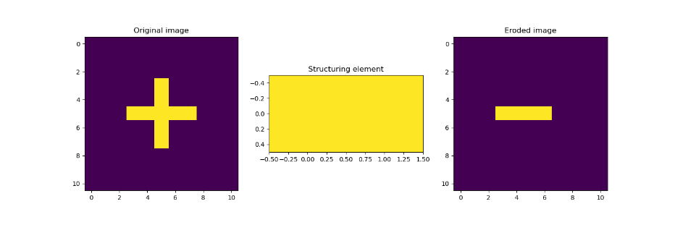
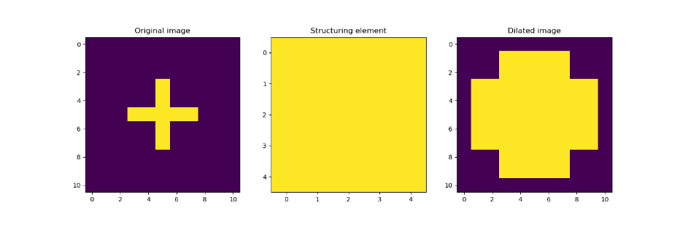
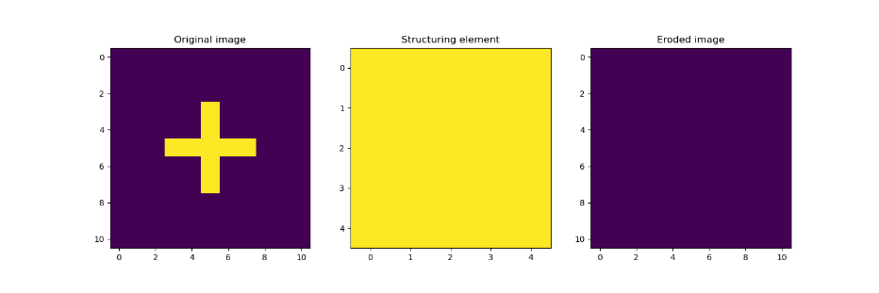
MORPHOLOGICAL OPERATIONS - NUMERICAL
Image: Plus symbol
Dilation
Erosion
In this case, we see that the only the dilation retains the plus image.
Since the second SE is a horizontal bar, it only fully fits on the horizontal line of the plus symbol.
Moreover, since the plus symbol is only one pixel thick, eroding it with a 2x2 and 5x5 square deletes the whole image since the squares do not fit anywhere in the image, as seen in the first and last images on the right.
Codes and files: https://github.com/genvert/AP_157_FX-2_Vertudez/tree/main/Activity%206

Slide 7
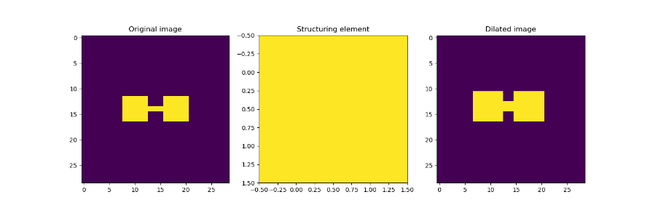
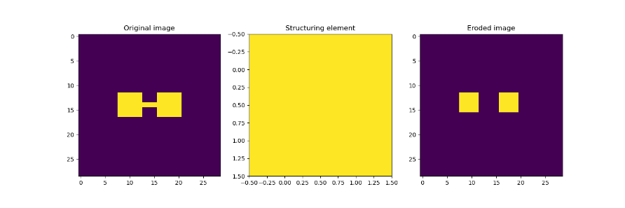
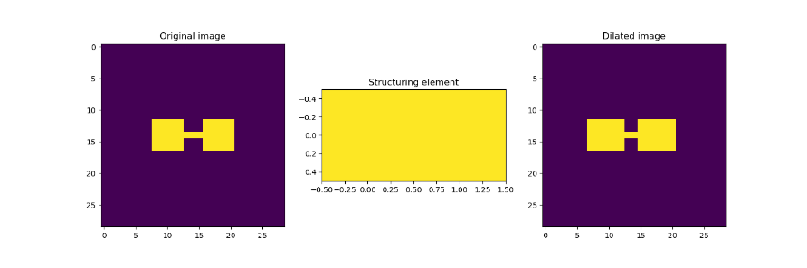
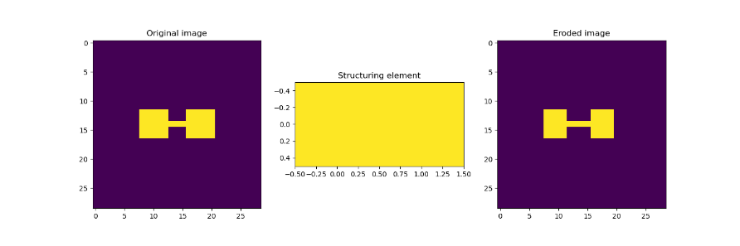
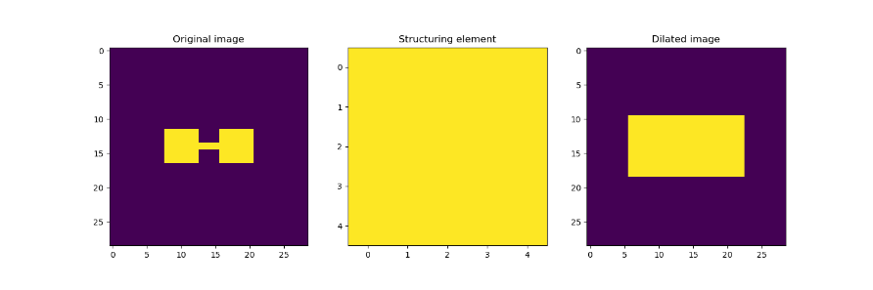
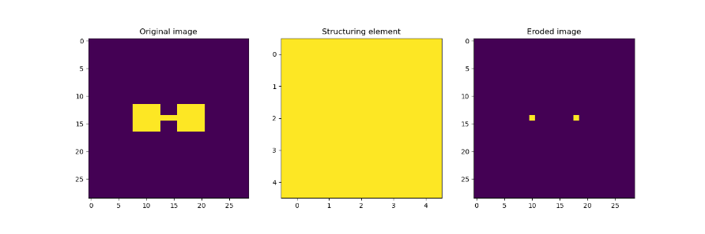
MORPHOLOGICAL OPERATIONS - NUMERICAL
Image: Dumbbell
Dilation
Erosion
Lastly, we see that the dumbbell shape is only retained on some of the image.
When the image is dilated with a 5x5 square, since the connector is just 3 pixels long, it gets covered totally as opposed when dilated with the 2x2 square.
Moreover, when it is eroded with 2x2 square, since the connector is only 1 pixel thick, it gets deleted. Then, eroding it with a 5x5 square only retains the center pixel of the “weights” since they are exactly 5x5 in size, and so the SE only fits right there.
Codes and files: https://github.com/genvert/AP_157_FX-2_Vertudez/tree/main/Activity%206

Slide 8
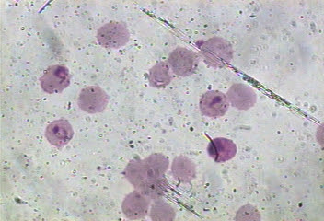
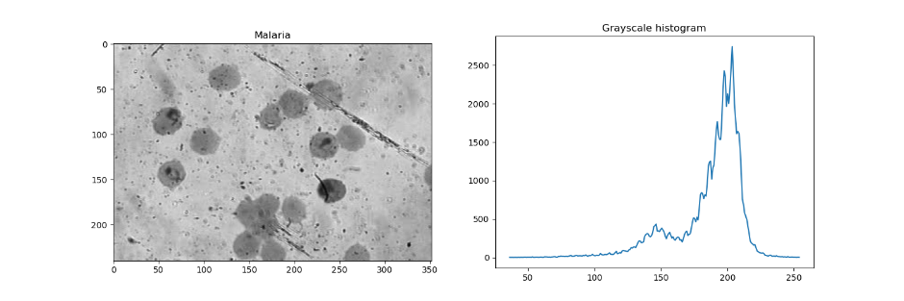
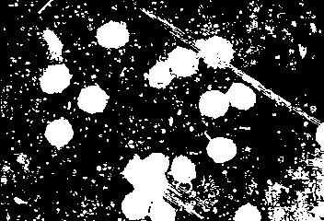
MORPHOLOGICAL OPERATIONS – MALARIA CELLS
Now, it is time to apply the morphological operations in order to “clean” an image segmented with techniques from the previous activity.
The image on the left shows malaria cells. We want to isolate the cells from the background. The grayscale histogram of the image is shown below on the left. Thresholding the histogram below 180, we obtain the segmented image below on the right. We see that we were able to isolate the cells, but there are a lot of unnecessary grains included. Using morphological operations, we can remove this, as we have seen from the examples on previous slides where some parts can be removed totally.
Original image
Grayscale image
Segmented image
Codes and files: https://github.com/genvert/AP_157_FX-2_Vertudez/tree/main/Activity%206

Slide 9
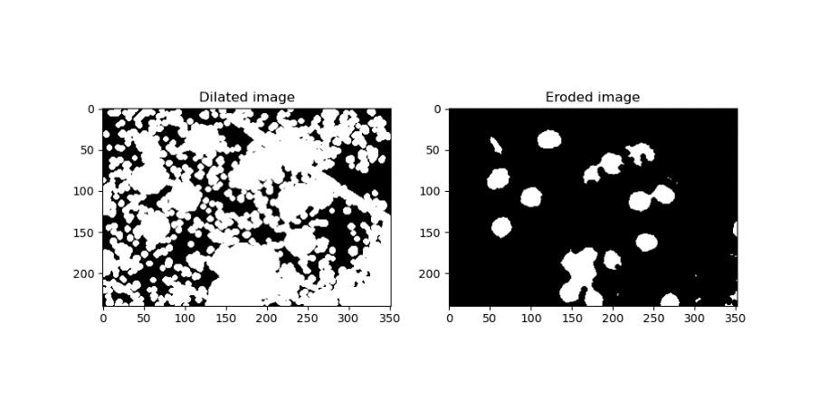
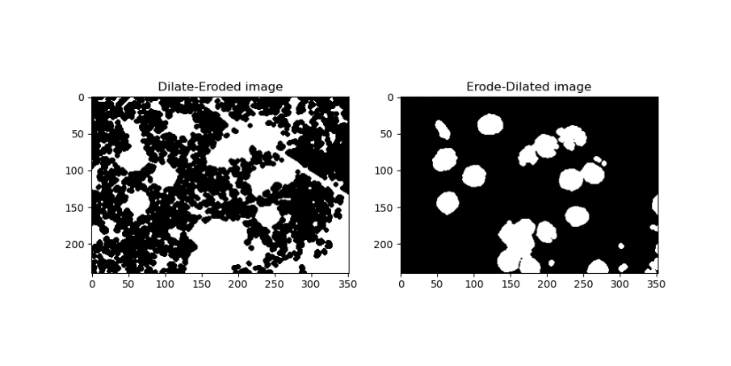

MORPHOLOGICAL OPERATIONS - MALARIA CELLS
For the malaria cells, I used a circular structuring element since the cells are circular. The size is small enough to not destroy the cells, but large enough to remove the unnecessary noise.
The images on the right shows different combinations of morphological operations applied to the segmented image. This way we can decide which best gives our desired result.
Note that the closing operation is the same as dilate-eroding an image, and the opening operation is the same as erode-dilating an image. Hence, the second and third image on the right is actually the same. I just performed both to verify that they indeed are the same.
Now, we see that the opening operation gave us the best segmented result.
Codes and files: https://github.com/genvert/AP_157_FX-2_Vertudez/tree/main/Activity%206

Slide 10

MORPHOLOGICAL OPERATIONS - MALARIA CELLS
Finally, we compare the original image to the cleaned segmented image on the left.
This final segmented image is what we will use for feature extraction in the next activity.
It is vital to try and produce the best segmented image since this will be the basis for extracting the features of the original image.
Original image
“Cleaned” segmented image
Codes and files: https://github.com/genvert/AP_157_FX-2_Vertudez/tree/main/Activity%206

Slide 11
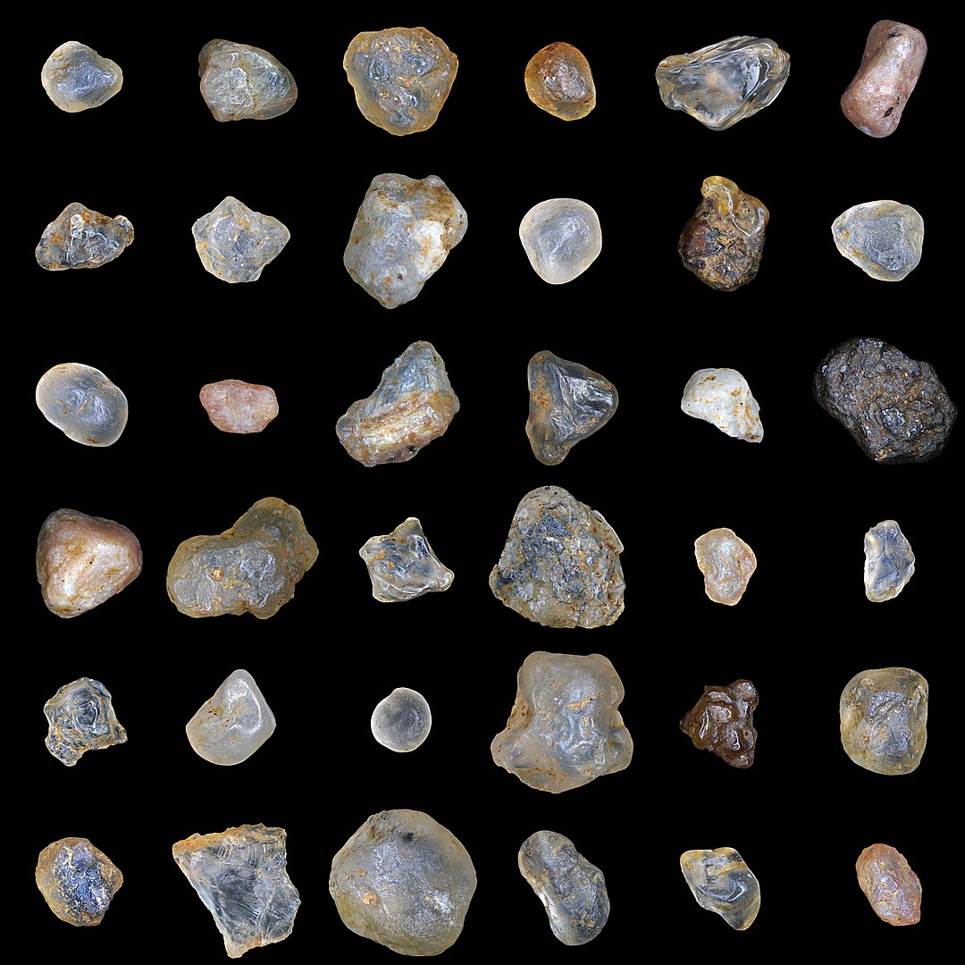
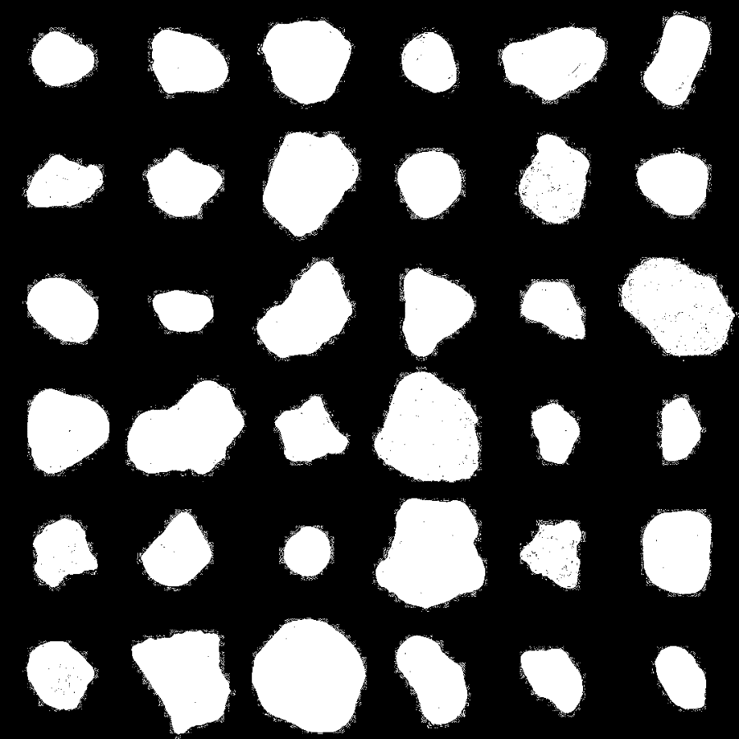
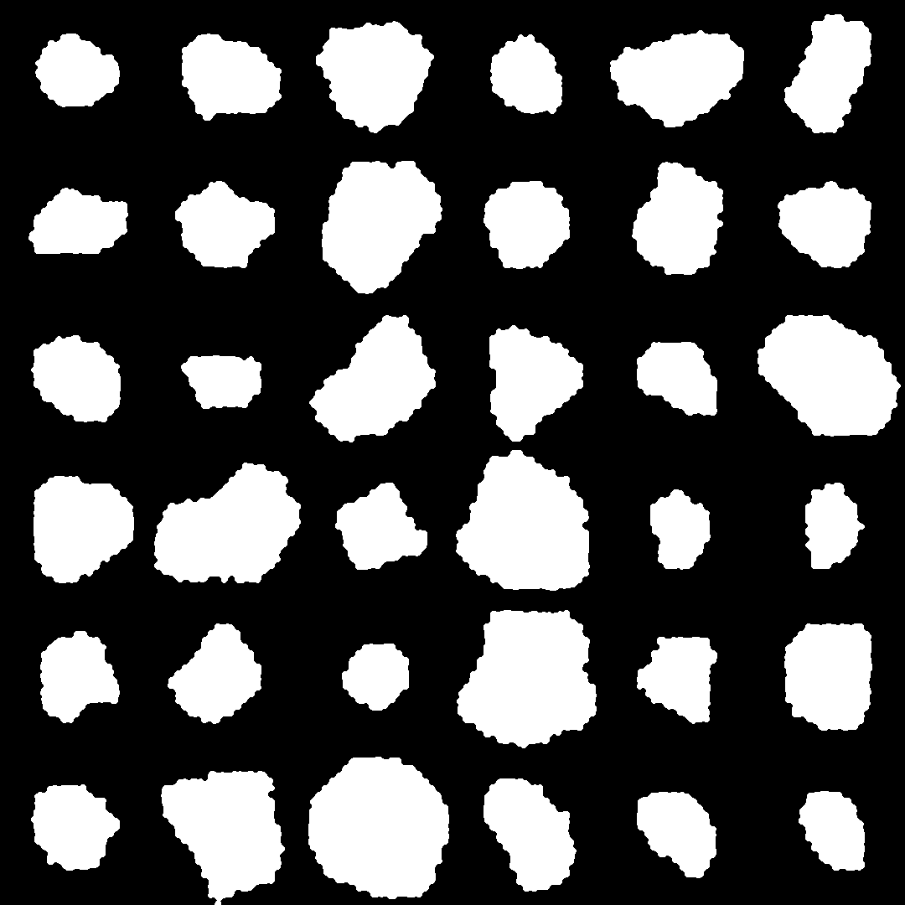
MORPHOLOGICAL OPERATIONS – SAND PARTICLES
Original image
Segmented image
“Cleaned” segmented image
Here is another example where I used the images from the ImageJ activity to see if I can have similar results. For the sand image, I used the closing operation twice, with the same structuring element I used for the malaria cells.
Codes and files: https://github.com/genvert/AP_157_FX-2_Vertudez/tree/main/Activity%206

Slide 12
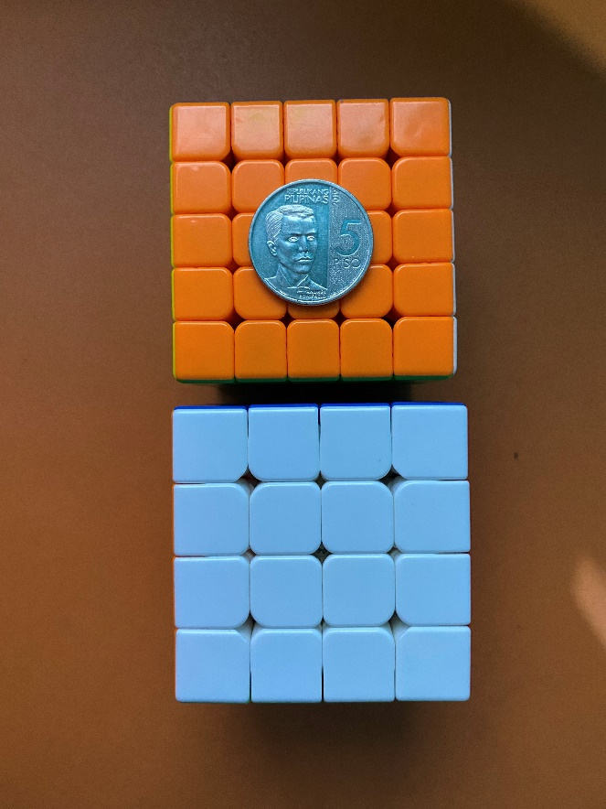
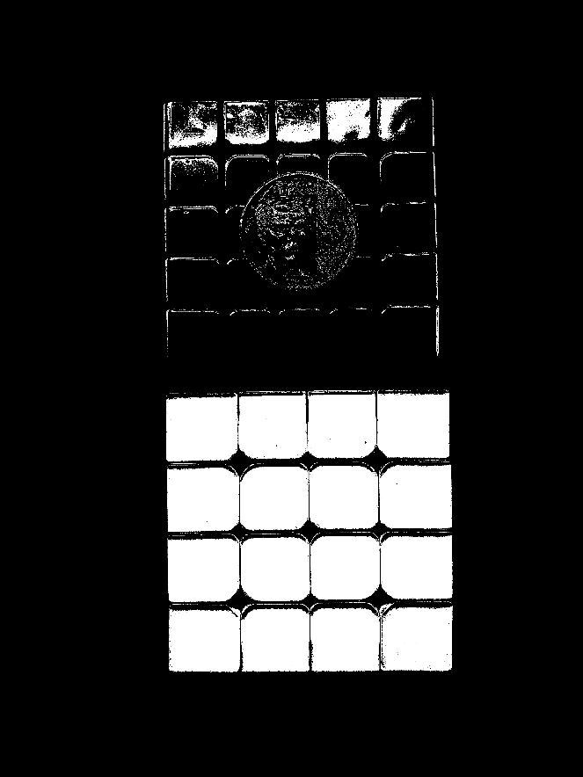
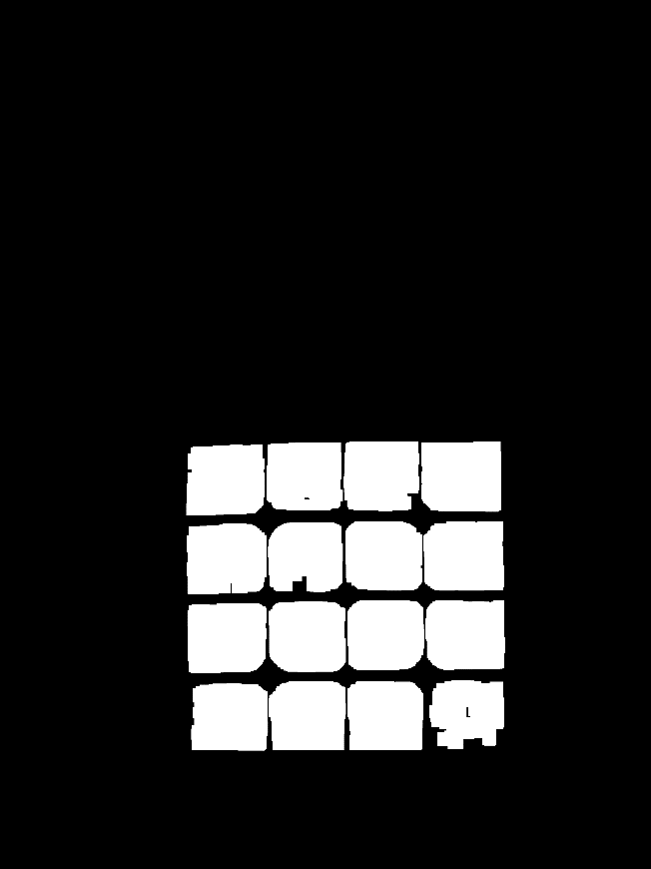
MORPHOLOGICAL OPERATIONS - CUBE
Original image
Segmented image
“Cleaned” segmented image
Here is another example where I used the images from the ImageJ activity to see if I can have similar results. For the Rubik’s cube, I used the closing operation twice, first with a larger square SE, and second with a smaller one.
Codes and files: https://github.com/genvert/AP_157_FX-2_Vertudez/tree/main/Activity%206

Slide 13
REFLECTION
This activity was somewhat a breather since it was fun and easy to do!
It was nice to look back at Set Theory because I am fuzzy with it.
I really enjoyed the manual mapping of the morphological operations and drawing it on a graphing paper. It was fun to visualize how the structuring elements will affect the images.
Lastly, I found it satisfying when a noisy segmented image gets cleaned up using morphological operators.

Slide 14
SELF-GRADE
Technical correctness: 35/35
I am confident that I understood how to experiment with combinations of morphological operations in order to gets the best “cleaned” segmented image.
Quality of presentation: 35/35
I have explained each step and idea, and images are clear and concise.
Self-reflection: 30/30
The activity was really fun and easy. I only slacked because I was stuck in the previous activity and again my bad habit is not trying other things when I am stuck in a previous thing.
Initiative: 10/10
I went beyond the expected output by trying the image I used in ImageJ activity.

Slide 15
REFERENCES
[1] Soriano, M. (2023). AP 157 module. A6- Morphological operation 2023.
[2] https://www.youtube.com/watch?v=bRa770kRapc&pp=ygUsbW9ycGhvbG9naWNhbCBvcGVyYXRpb25zIGluIGltYWdlIHByb2Nlc3Npbmc%3D
[3] https://www.youtube.com/watch?v=d1we_yqUASg&t=640s&pp=ygUsbW9ycGhvbG9naWNhbCBvcGVyYXRpb25zIGluIGltYWdlIHByb2Nlc3Npbmc%3D
[4] https://www.youtube.com/watch?v=2LAooUu1IjQ&pp=ygUsbW9ycGhvbG9naWNhbCBvcGVyYXRpb25zIGluIGltYWdlIHByb2Nlc3Npbmc%3D

